Slide 1

Modern App Deep Dive
With C# and XAML
Brent Edwards
Principal Lead Consultant
Level: Intermediate

Slide 2
C#/XAML vs HTML/JS
Which is right for you?

Slide 3
C#/XAML vs HTML/JS
Which to choose?
Depends on your team’s background
Web background?
HTML/JS is the best bet
Biggest drawback: WinJS is very specific to Windows
Silverlight or WPF background?
XAML is the clear winner
Biggest drawback: Doesn’t have all the bells and whistles of the latest WPF or Silverlight

Slide 4
C#/XAML vs HTML/JS
What about cross platform with WP8?
C#/XAML is only choice

Slide 5
MVVM
Model-View-ViewModel

Slide 6
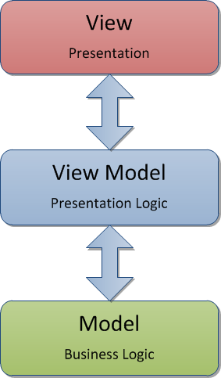
MVVM

Slide 7
Why is MVVM Cool?
Separates Presentation from Functionality
Promotes Testability
Works great with Data Binding
Easy collaboration with Designers
Makes it easy to change out the View layer!

Slide 8
MVVM Frameworks
Some frameworks support WinRT
Caliburn.Micro
MVVM Light
Both support
Navigation
Event Aggregation
Ability to bind events to view model
Caliburn.Micro has more robust binding support

Slide 9
The ApplicationBar: Anti-MVVM
Why Anti-MVVM?
Not part of Visual Tree
Doesn’t inherit from FrameworkElement
What does that mean?
No Data Binding
No routing events to View Models
What’s a dev to do?
Wrap it up!

Slide 10
Bindable appbar
[DEMO]

Slide 11
Crossing the platforms
WinRT and WinPRT

Slide 12
Cross-Platform with WinRT and WinPRT
It can be done!
Requires some planning
Separation of Concerns
MVVM really shines
Two projects, one code file
Add As Link is awesome

Slide 13
Cross-Platform Solutions
Need platform-specific projects
Windows Store
Windows Phone 8
Both projects use same code files
Add as reference
Keep namespaces agnostic

Slide 14
Platform Specific Views
Views have to be different
Different Flavors of XAML
Different Controls
What is cross-platform?
The design
Windows Phone, meet WinRT Snap View
Snap View has 320px fixed width

Slide 15
What type of things are different?
Navigation
WinRT takes an object as parameter
WinPRT passes parameters in query string
Message Boxes
WinRT uses MessageDialog and is Async
WinPRT uses MessageBox is is NOT Async
Choosing Photos
WinRT uses FileOpenPicker with file type filters
WinPRT uses PhotoChooserTask

Slide 16
How do you deal with differences?
3 Options
Compiler Directives
WinRT defines NETFX_CORE
WinPRT defines WINDOWS_PHONE
Abstraction
Define an interface, let each project implement it
Abstraction + Compiler Directives
Move compiler directives behind abstraction layer

Slide 17
Navigation
Uri based
Uri points to the View
ViewModels have to know about Views?
Not with Caliburn.Micro
ViewModel-first navigation
Handles Uri resolution for you

Slide 18
Navigation
Navigation Parameters are a key difference between WinRT and WinPRT
WinRT
One parameter of type Object
WinPRT
Query string parameters
How to handle this?
Serialize parameter to string first

Slide 19
Cross-platform
[DEMO]

Slide 20
Azure mobile services

Slide 21
Azure Mobile Services
Primary Features
Authentication
Push Notifications

Slide 22
Authentication
oAuth done easy
4 Auth Options
Twitter
Facebook
Microsoft
Google
Biggest Drawback
Users have to remember which option they chose

Slide 23
Authentication
Things to consider
Is your app open to anyone?
Does your app need domain authentication?
If so, Azure Mobile Services is probably not the best option for auth

Slide 24
Push Notifications
Deliver info to your users through notifications
Tile
Badge
Toast
Things to consider
How can your Tile be more Live?
What info to show in Toasts?

Slide 25
Azure Mobile Services
[DEMO]

Slide 26
Leveraging the business layer

Slide 27
Leveraging the Business Layer
A little planning goes a long way
The same code can be used on
Server (.NET)
Client (WinRT/WinPRT)
N-Tier business layers can leverage
Compiler directives
Different project types

Slide 28
Leveraging the business layer
[DEMO]

Slide 29
contracts
Windows 8.1

Slide 30
Contracts
What are they?
Agreements between one or more apps
Provide consistency across all apps

Slide 31
Examples of Contracts
Search
Share
Settings
Play To
File Picker
Cached File Updater

Slide 32
Contracts
Contracts You SHOULD Leverage
Search
Share
Settings
You HAVE to use this one with Internet access
Why?
Always available via Charms menu

Slide 33

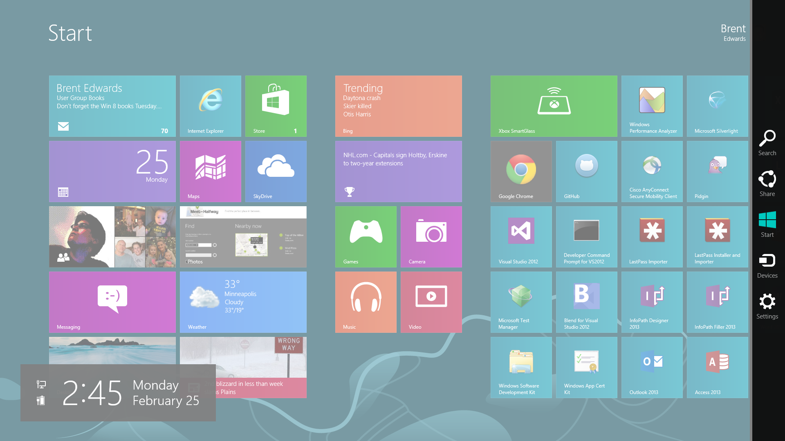
Charms Menu

Slide 34
Search
Search your app from anywhere in the OS
Things to consider
What can be searched?
Search complexity?
Parsing?
How to display?

Slide 35
Search
[DEMO]

Slide 36
Share
Share content from your app
Can be context specific
Content can be shared in many formats
Different apps support different formats
Support as many formats as possible
Fire and forget
One format: Custom URIs

Slide 37
share
[DEMO]

Slide 38
Settings
Change settings in your app
Any app-wide settings should go here
Users will be conditioned to use this

Slide 39
Settings
Things to consider
What app-wide settings will you need?
How can they be simplified?
How will changing them affect the UI?
Changes should be reflected immediately
Will you use the Internet?
If so, you MUST provide a privacy policy

Slide 40
settings
[DEMO]

Slide 41
Application Settings

Slide 42
Application Settings
Both platforms have very similar functionality
Different classes involved
Neither implementation can be easily mocked for unit testing

Slide 43
Application Settings
Solution
Provide consistent interface
Use compiler directives in implementation

Slide 44
Application Settings
[DEMO]

Slide 45
Azure blob storage

Slide 46
Azure Blob Storage
WinRT: A Couple of Options
WinRT Library
REST API
WinPRT: Not like WP7 or WinRT
No library to leverage
REST API is only choice

Slide 47
Azure Blob Storage Library (WinRT)
Nuget Package
Gives access to containers and blobs
Can use credentials directly
Or, better yet…

Slide 48
Storage Access Security (SAS)
What is it?
Temporary key
Has built-in expiration
SAS keeps credentials out of client
Recommend generating on server

Slide 49
REST API
Provides all Blob Storage functionality
Create containers
Upload blobs
Can use credentials directly
Better yet, use SAS

Slide 50
Azure blob storage
[DEMO]

Slide 51
Secondary Tiles
Deep Linking

Slide 52
Secondary Tiles
What are they?
Additional tiles pinned to Home screen
Provide deep-links into your app
Can pin programmatically
Need to handle when activated
Things to think about
What is most important in your app?
What can users jump straight to?

Slide 53
Secondary tiles
[DEMO]

Slide 54
Unit testing

Slide 55
Unit Testing
Almost the same as .NET
Runs right alongside .NET tests in MSTest
Biggest Difference?
No Reflection.Emit namespace
Which means?
No mocking frameworks!
Have to hand roll all mocks

Slide 56
Unit testing
[DEMO]

Slide 57
What We Covered
C#/XAML vs HTML/JS
MVVM
Crossing the Platforms
Azure Mobile Services
Leveraging the Business Layer
Contracts
Azure Blob Storage
Unit Testing

Slide 58
Useful Links
Windows Azure
http://www.windowsazure.com/en-us/
Windows Dev Center
http://www.windowsstore.com/
Windows Phone Dev Center
https://dev.windowsphone.com/en-us

Slide 59
Questions?

Slide 60
Brent Edwards
BrentE@magenic.com
@brentledwards
http://www.brentedwards.net
https://github.com/brentedwards

